Slide 1
RWI Phonics information meeting January 2023

Slide 2
The purpose of this session is to:
Inform you about how RWI is structured and coverage
Discuss any ‘terminology’ that you may hear your child use and what it means
Support you to support your child at home in various ways
Please feel free to ask questions at the end of the presentation.

Slide 3
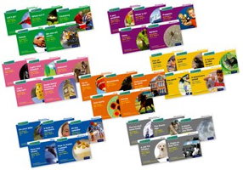
RWI Books -
RWI is split into colours and phases -
Sound blending books
Ditty sheets
Red Ditty books
Green story books
Purple story books
Pink story books
Orange story books
Yellow story books
Blue story books
Grey story books
Within each of these phases red upwards there are school reading books and home reading books. The school reading book is read each day within the group session that your child is in and at the end of that week it is then sent home alongside the corresponding home book. These correspond because they have the same phonic sounds in and red words. This consolidates learning.
Sound blending books are sent home with sounds to practise as they are learnt and again changed weekly.
Ditty sheets are also sent home weekly alongside the corresponding home ditty.

Slide 4
Progression of RWI -
In Nursery we begin early synthetic phonics activities which develops phonological awareness.
In Reception we begin daily RWI sessions in which we learn three new sounds every week. We cover set 1 and set 2 sounds. Once all sounds are taught we consolidate to ensure children are secure.
In Year 1 and 2 we continue with daily RWI sessions, these children recap set 1 and set 2 sounds and also learn new set 3 sounds, which are all the variations of the sounds we have learned already. This is until the child is ‘off’ RWI and then they change to do English lessons.
If children are still in need of RWI after Year 2 then they receive daily intervention as they must have a daily English lesson.
In June in Year 1 - all children are expected to complete the Year 1 phonics screening check. The aim is to check that a child is making progress in phonics. They are expected to read a mixture of real words and ‘nonsense’ words.
Please see progression grid attached separately and or printed out if you are at the session.

Slide 5
Phonics terminology -
Phoneme - is the smallest unit of sound in a word - such as ‘cat’ has three phonemes - c/a/t
Grapheme - is the way we write a phoneme - such as ‘rain’ has three phonemes - r/ai/n
ai can be written in various ways - rain, May, straight, make, weigh
Digraph - two letters make one sound such as - sh,th,ng,ay etc in RWI we also call these ‘special friends’
Trigraph - three letters make one sound such as - air, igh
Split digraph - where the sounds are split with a consonant e.g. rake, these, mine, tune
Segmenting - Segmenting is the process of breaking a word down into its individual sounds. For example the word cat is made up of three sounds. This can be written or orally.
Blending - Blending is the process of combining sounds together to create a word. For example, the word cat is made up of three sounds /c/-/a/-/t/ together these sounds produce the spoken word cat.

Slide 6
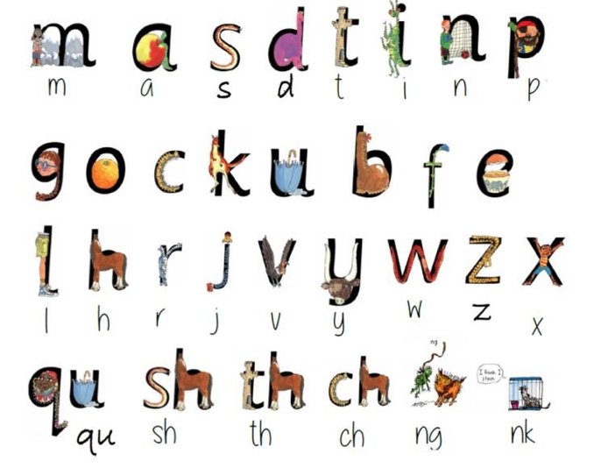
RWI Set 1 sounds

Slide 7
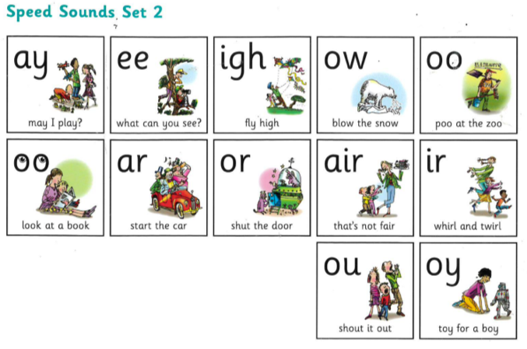
RWI Set 2 sounds

Slide 8
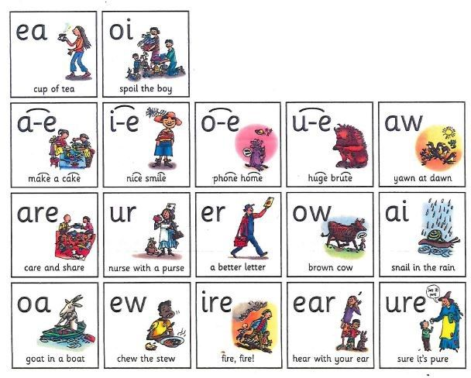
RWI Set 3 sounds

Slide 9
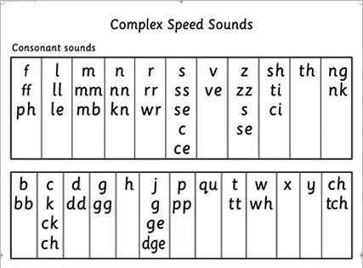
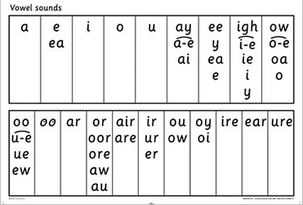
The same sound but a different grapheme…

Slide 10
What does a RWI session look like?
Each RWI session follows the same format and includes -
New sound taught/recap of previous sounds
Fred talk - this is where the children ‘sound out’ to blend the green words
Fred in head - this is where we encourage children to blend in their head and read the word
Nonsense words - are silly words that allow children to show their phoneme awareness - such as - quob, shad, quape
Story green words - words that are in the story they are covering that week - practise daily so we can build on speedy reading
Red words - such as - I, my, he, she, the, we etc. These words can not be blended and so we need to learn by sight
Speedy green words - these are key words in the books we share that we can have a go at reading quickly by sight
Ditty/book reading - we read our designated text as a group and with a partner
Get writing task - a writing task linked to what the children have read, such things as complete the sentence and hold a sentence

Slide 11
Example of how a child might write a word or sentence phonetically
I luv you
Wee went up too spays
Wons up on a tighm
I mayd a picha
The cowt is bloo

Slide 12
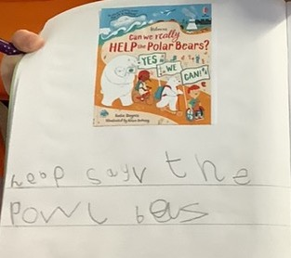
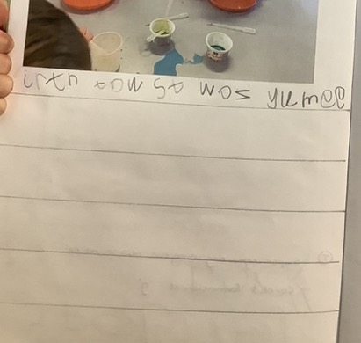
Some written examples-

Slide 13
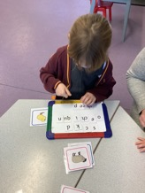
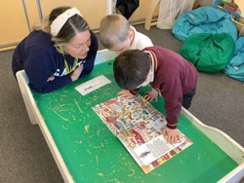
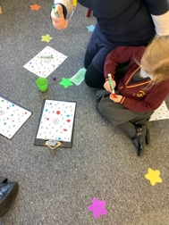
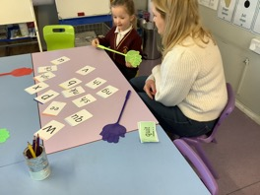
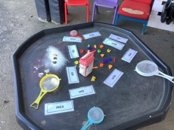
Games to play at home to make phonics fun -
A link to a previous filmed video with some game ideas - https://www.youtube.com/watch?v=6Ph69YOCkuE
Bingo
Dab the sounds
Where’s Wally - or any books - have a list of words you know your child could have a go at decoding such as ‘bus’ - can they find the picture of the bus?
Splat the sound
How many words can you write down that have the ‘sh’ sound in one minute?
Build words with magnetic letters or with their sound cards

Slide 14
Phonics websites and apps -
www.phonicsplay.co.uk
www.topmarks.co.uk
www.phonicsbloom.com
www.timeforphonics.co.uk

Slide 15
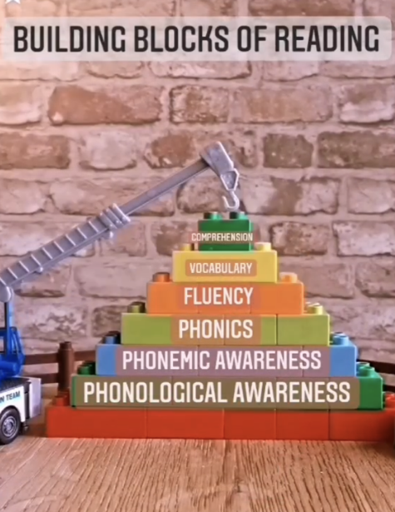
RWI builds upon the building blocks of reading in a systematic way.
THANK YOU FOR JOINING US ANY QUESTIONS PLEASE JUST ASK.

